Slide 1


FinAdvisor AI
By Hackers Space
2024 Reboot@LTC
LTC-confidential
LTC-Hackers-space team Presentation

Slide 2

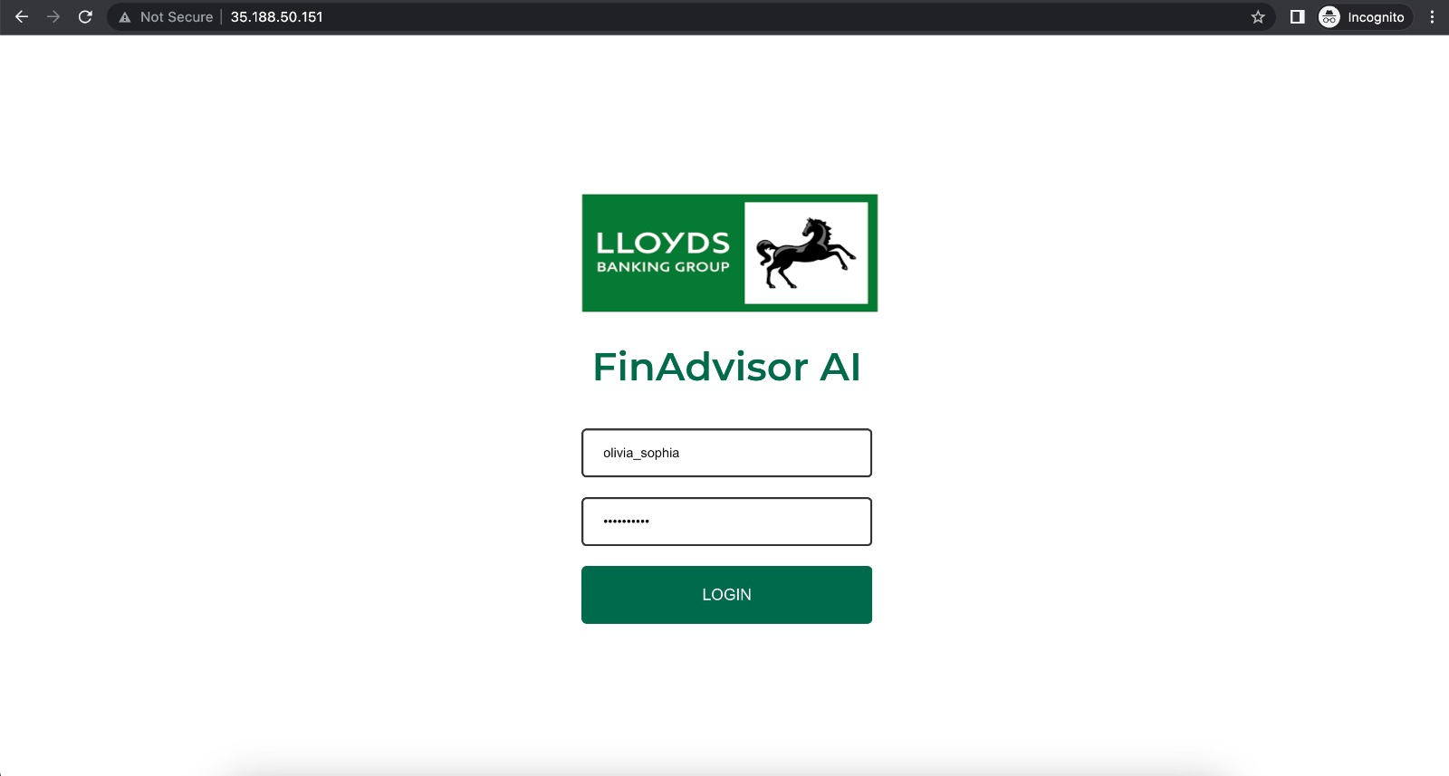

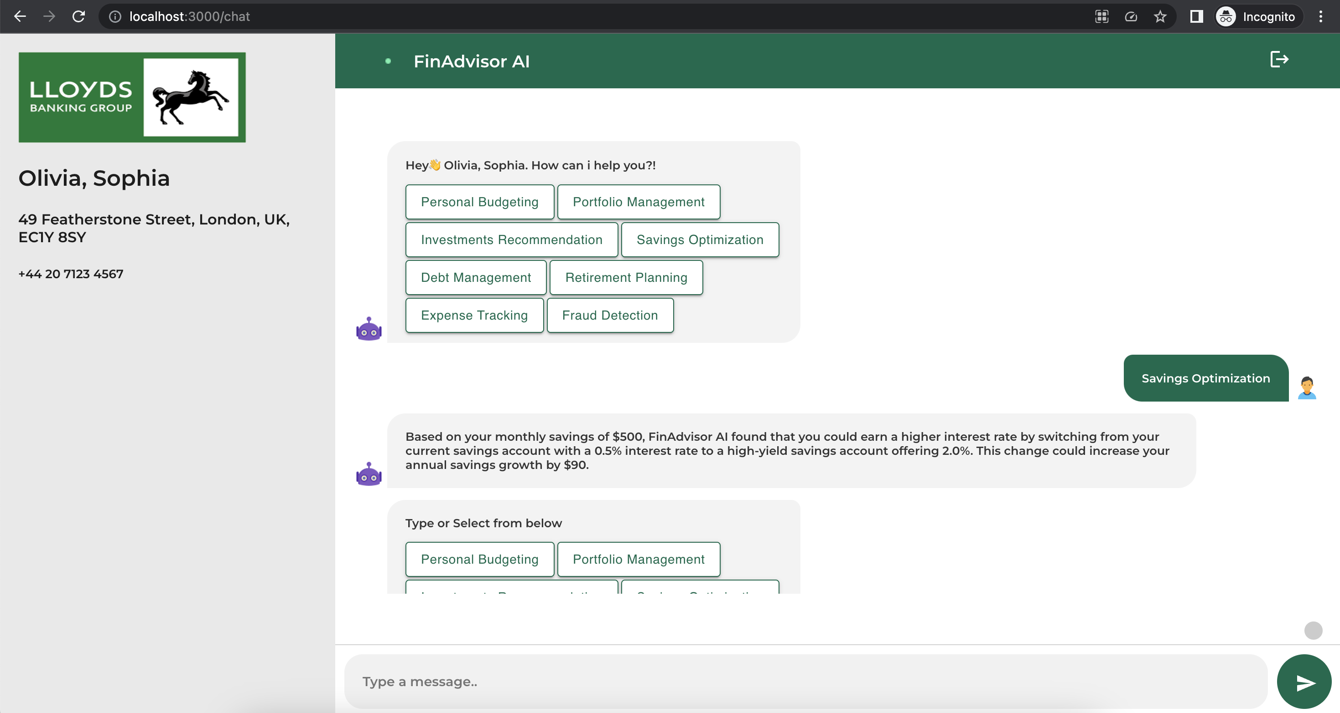
FinAdvisor AI Introduction
FinAdvisor AI empowers customers by providing seamless access to their data, coupled with comprehensive insights and analytics.
This enables customers to make informed decisions and optimize their business strategies, driving success and growth in their ventures.
LTC-confidential
LTC-Hackers-space team Presentation

Slide 3
FinAdvisor AI Product Features ( D-G-F-S model)
Data at Fingertips
Guide
Personalized answers to all transaction related data to the customers. E.g. Which store of mine had the least turnover last month?
Guidance provided on common issues or regulatory questions customers have.
Example : How to reduce Chargebacks?
D
G
Smart
F
Fast
S
Customers can access the app 24/7 and because their data is readily available to the app, customers can avoid calls or emails to customer care for any queries.
The app uses AI/ML, which makes the app capable of continuously acquiring new knowledge, elevating customer experiences to unprecedented levels over time
LTC-confidential
LTC-Hackers-space team Presentation

Slide 4

Value Propositions
Marketing
Analytics
Users
CRM
The Web App can be integrated as an enhanced experience for customers
Smart and Fast query resolution platform
Easing workload on customer care team (Cost reduction)
Enhancing customer trust in our application's data security and compliance.
24/7 Technical Support
The solution is targeted for patrons,SMB customers and large-scale customers
The app has a record of the FAQs by the customers, which might help LLOYDS to create an avenue using which we can educate the customers on such issues
Increasing LLOYDS’s Customer Satisfaction (CSAT) score, and thus increasing Customer Loyalty and reducing Churn
Platforms
Backend Sever: Python FastAPI Server
Frontend Server: React
ML Model: Offline ML model which runs within LLOYDS systems
Modalities
The Solution can be accessed using Voice or Text on a computer/phone’s browser
Cost Structure
Background Tasks
Minimal overhead to implement this Solution as we have the data readily available; and the technology used is open-sourced
NLP – Natural Language Processing
Intent Recognition
Dialogue Management
Knowledgebase Access
LTC-confidential
LTC-Hackers-space team Presentation

Slide 5
Potential Use Cases of FinAdvisor AI
Budgeting
Analyze spending patterns and suggest budgeting strategies.
Investment
Offer tailored investment advice based on risk tolerance and financial goals.
Debt Management
Provides strategies for efficiently paying off debt
Savings
Identifies ways to optimize savings through better interest rates or investment options.
Retirement Planning
Assists users in planning for retirement with projections and savings strategies.

Slide 6
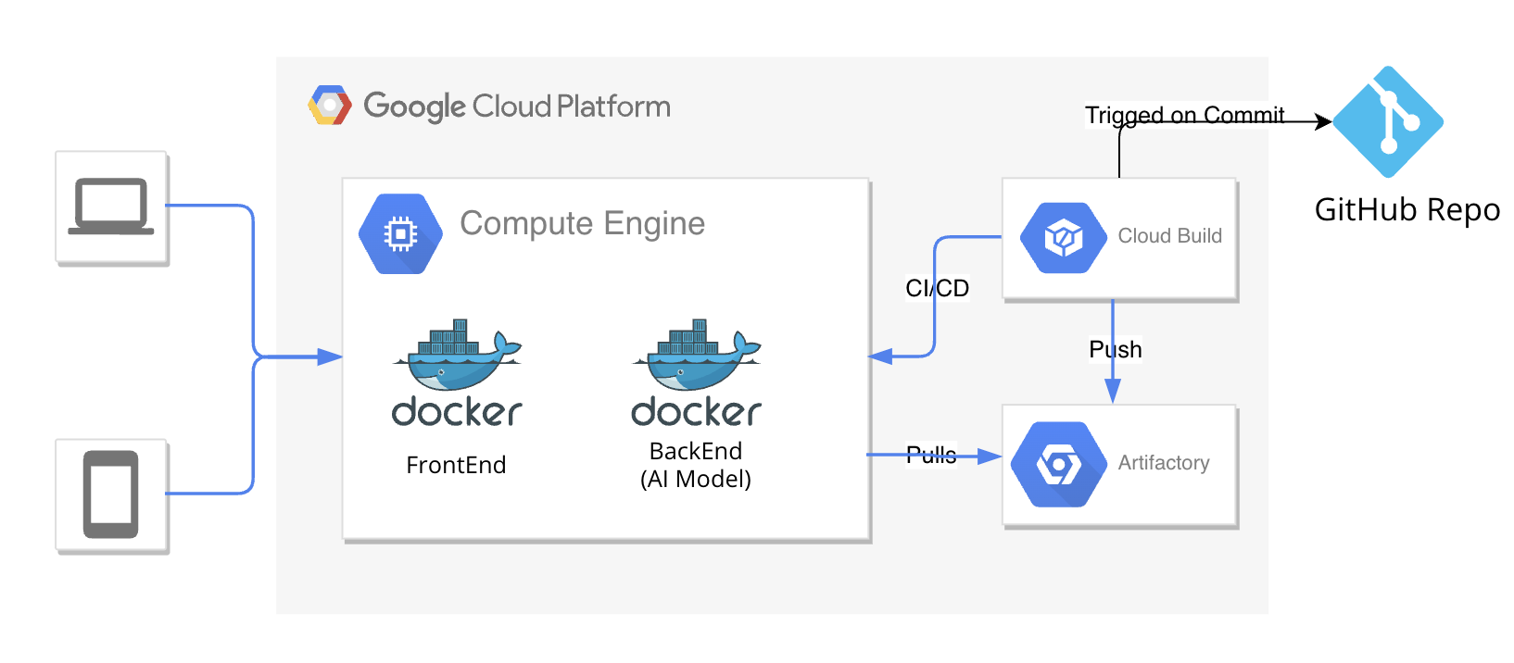
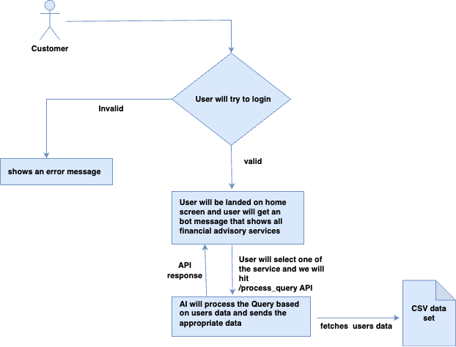
Architecture & Workflow Diagram
Cloud Architecture
Workflow Diagram
LTC-Hackers-space team Presentation

Slide 7

DEMONSTRATION
GitHub APP
LTC-Hackers-space team Presentation

Slide 8





Living with Values
People-first
Trust
Sustainable
Offers personalized financial plans and increases customer satisfaction
Ensures data security and transparent decision-making processes.
Use of green data centers and comprehensive carbon offsetting initiatives.
Bold
Inclusive
FinAI break down barriers to financial planning and offers high-quality services
Identifies innovative investment opportunities.
LTC-Hackers-space team Presentation

Slide 9
Future Enhancements & Vision
Integration with Financial Institutions
Real-time data updates
Advanced Predictive Analytics
User-friendly Mobile App
Enhanced Security Measures
Robust encryption and data protection protocols
Future Enhancements
LTC-confidential
LTC-Hackers-space team Presentation

Slide 10
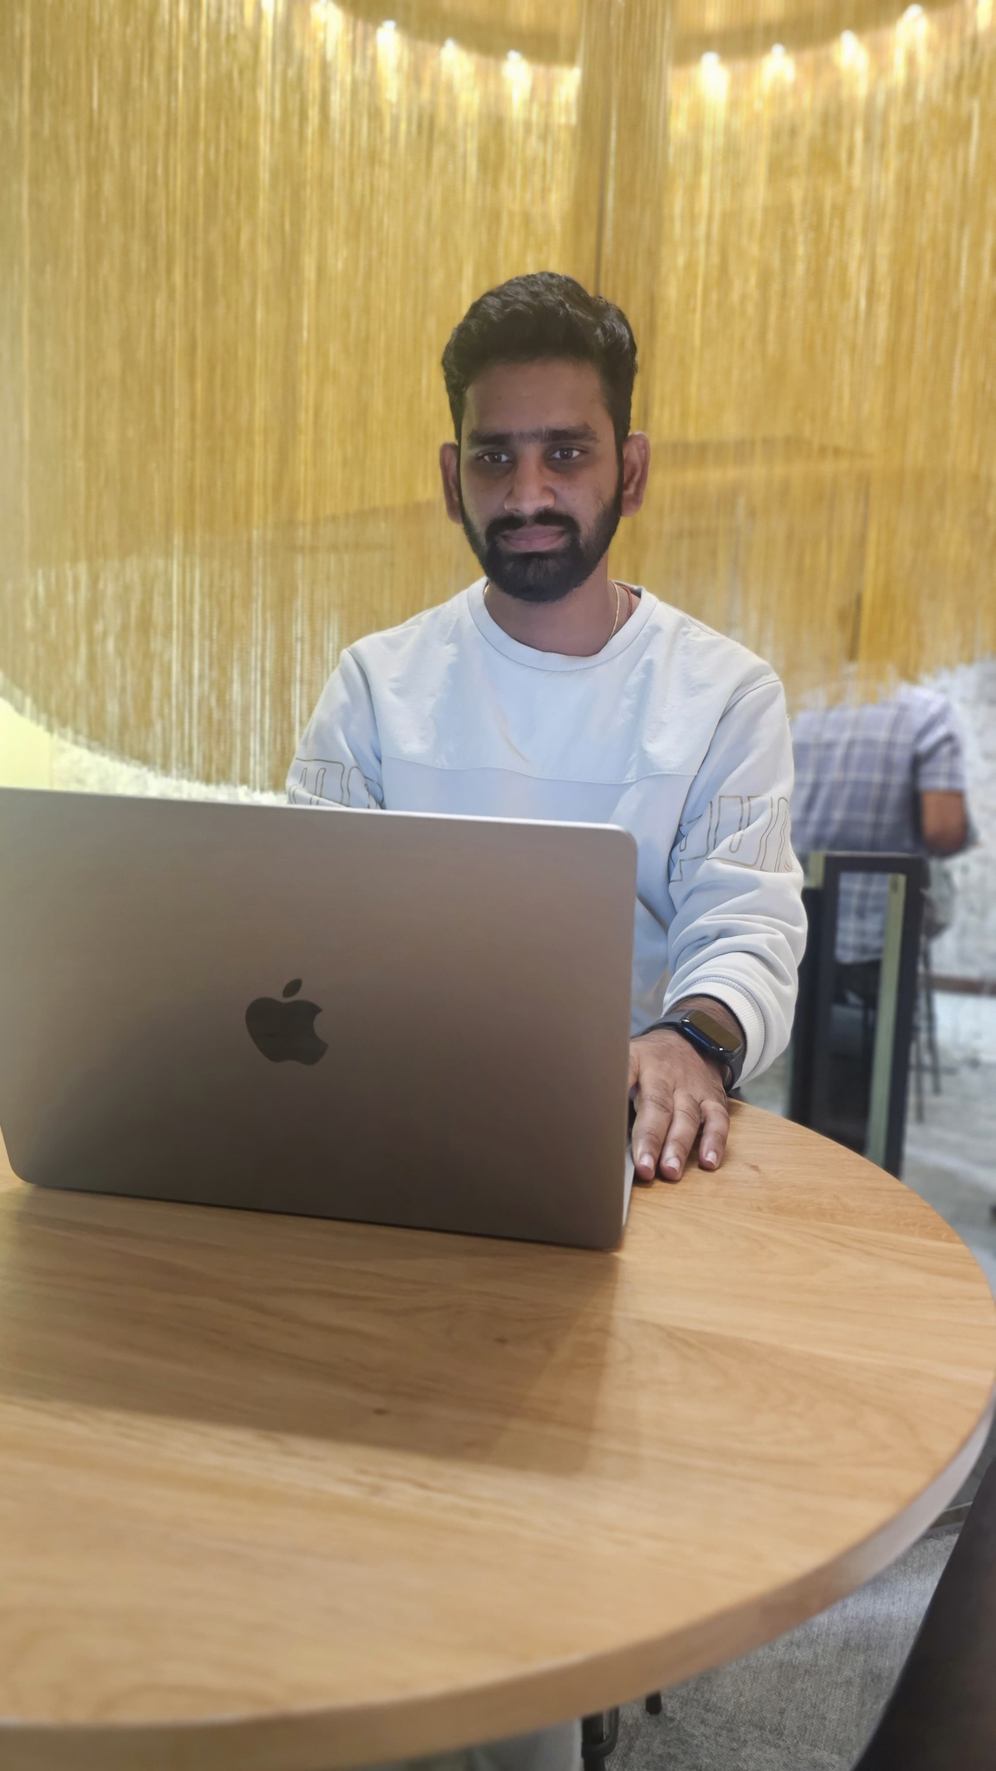


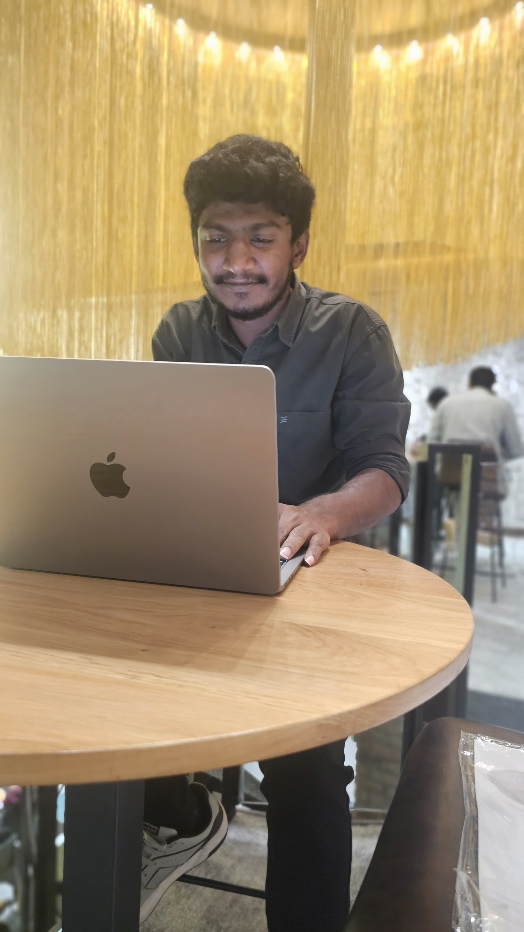
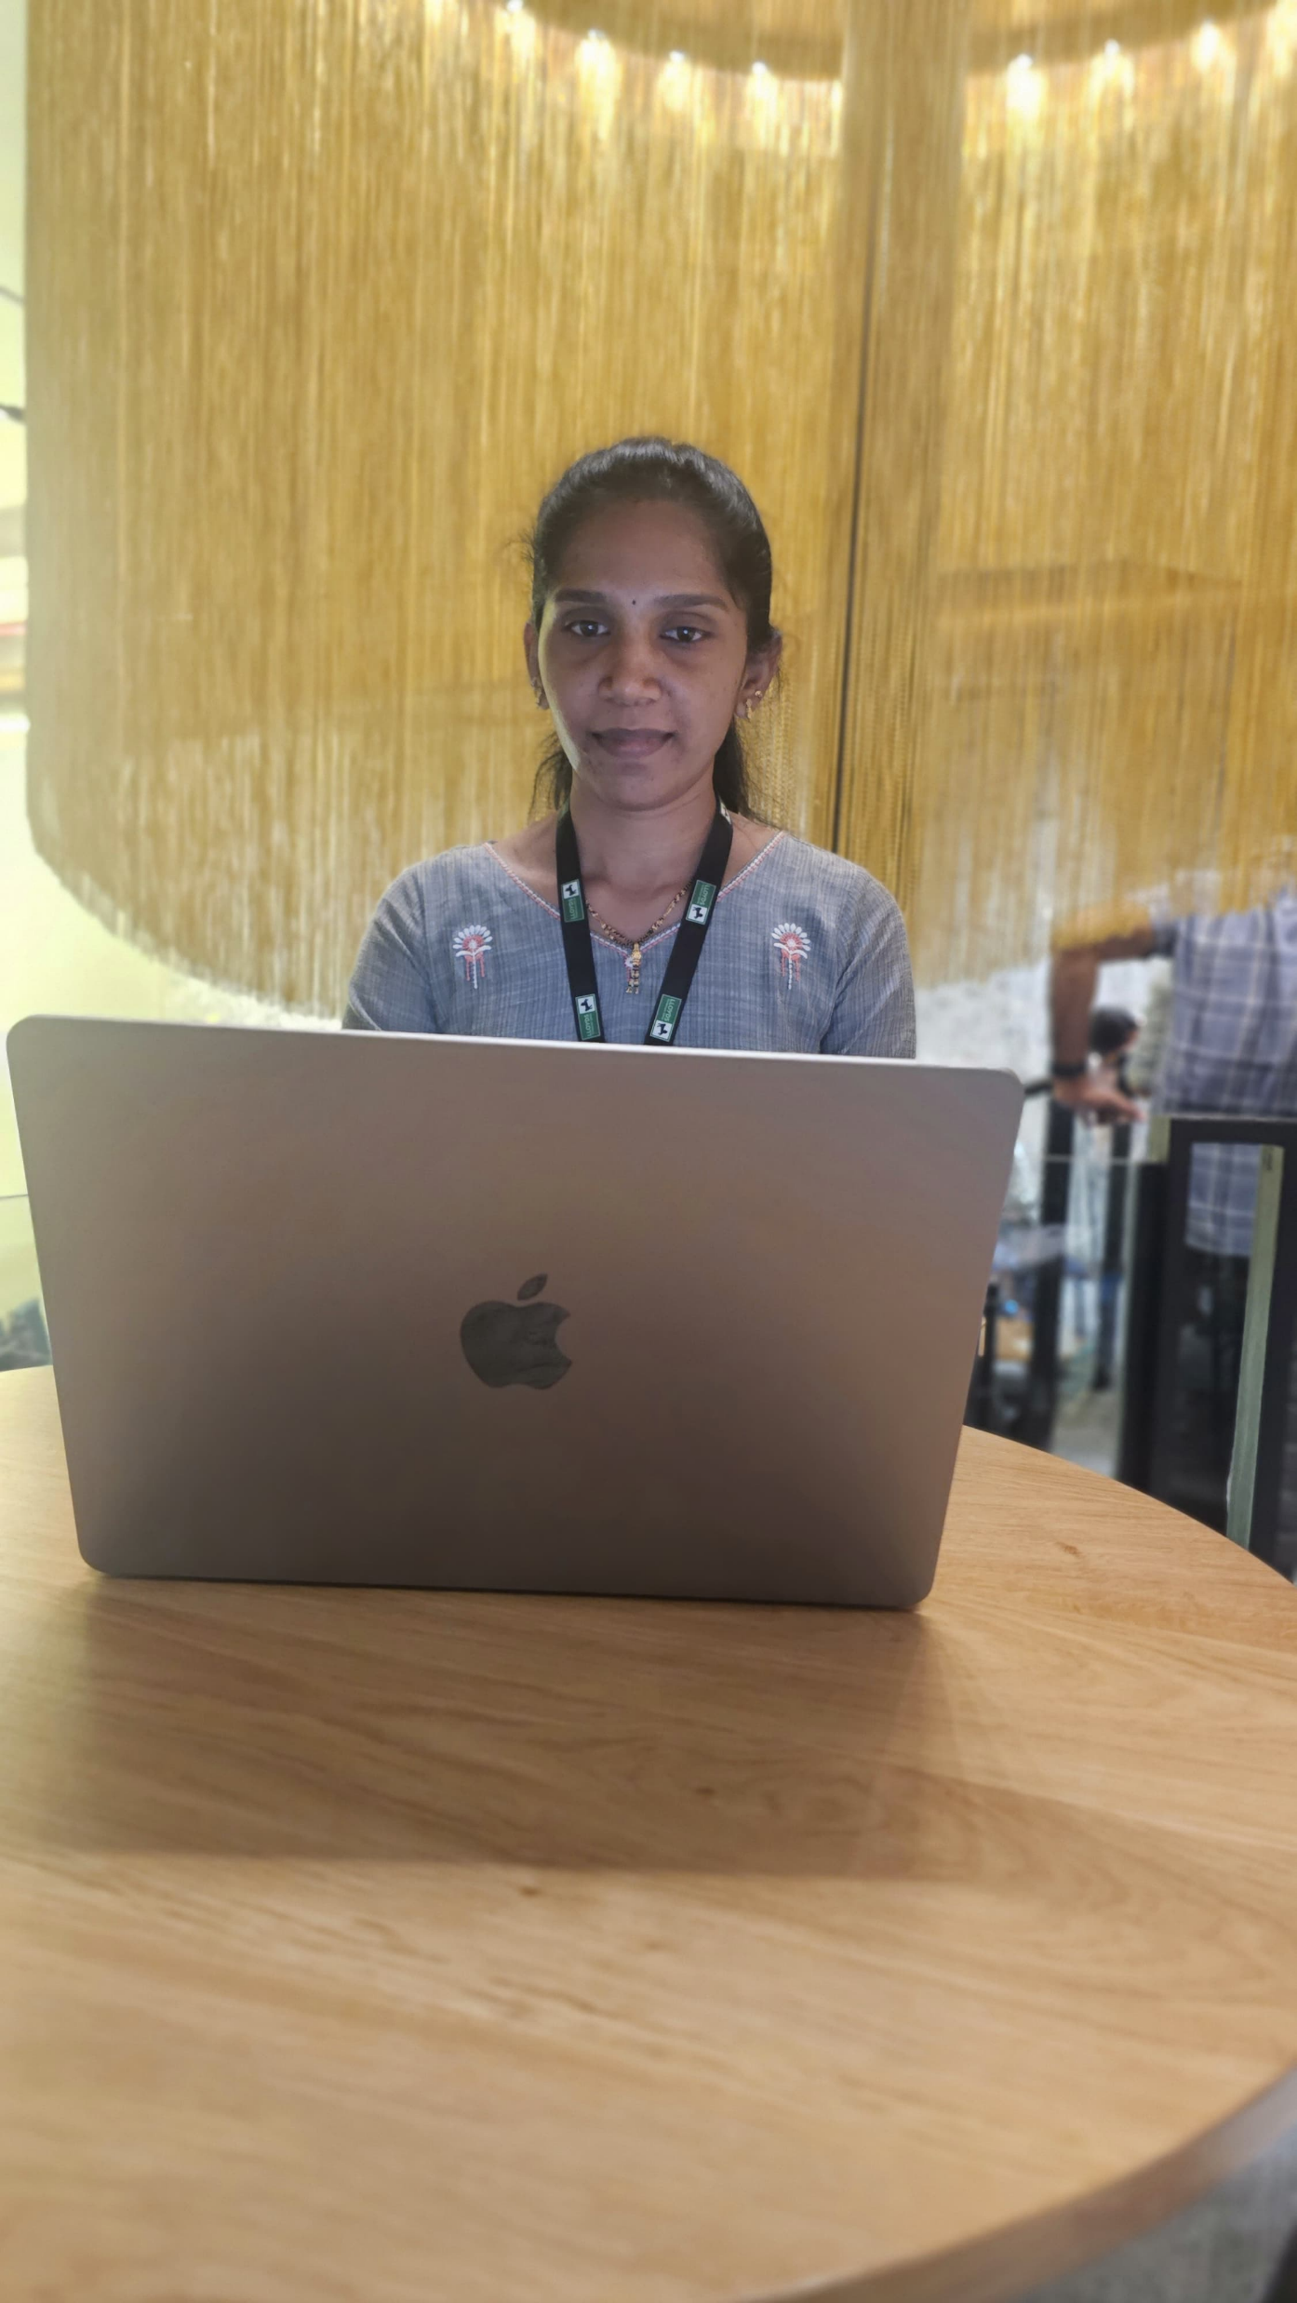
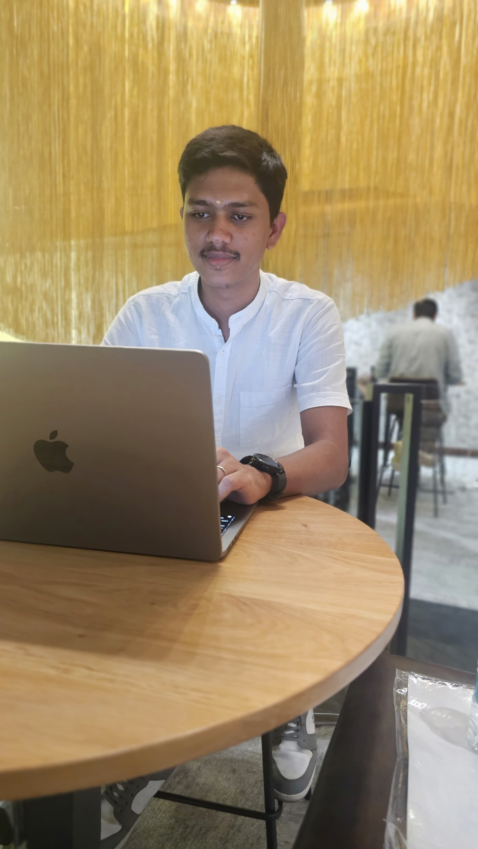
Meet the Team
Kadavergu Anudeep
Burra Manikanta
Kolla Sai Rahul
Associate Engineer
Software Engineer(MERN)
Data Engineer/DevOps
Repalle Sirisha
Vaidyanathan
Senior Quality Engineer
Associate Engineer

Slide 11
THANK YOU
LTC-confidential
LTC-Hackers-space team Presentation

